Slide 1
Enabling Ocean Observation Capacity to Support
Climate Resilience
Vladimir Ryabinin
Executive Secretary, Intergovernmental Oceanographic Commission;
Assistant Director-General, UNESCO
OCEANS DAY AT COP 21
4 December 2015

Slide 2

From science to policy
Marine Science
e.g.
GOOS
HAB
OBIS
JCOMM
Working Groups on emerging issues, e.g. Blue Carbon, OA, Deoxygenation (e.g. IOCCP, GOA-ON, Blue Carbon Initiative)
Assessments
e.g.
IPCC
IPBES
CBD reports
GESAMP
WOA
Sustainable development policies
e.g.
Post-2030 agenda
UNFCCC
UNCLOS
CBD
S.A.M.O.A.

Slide 3
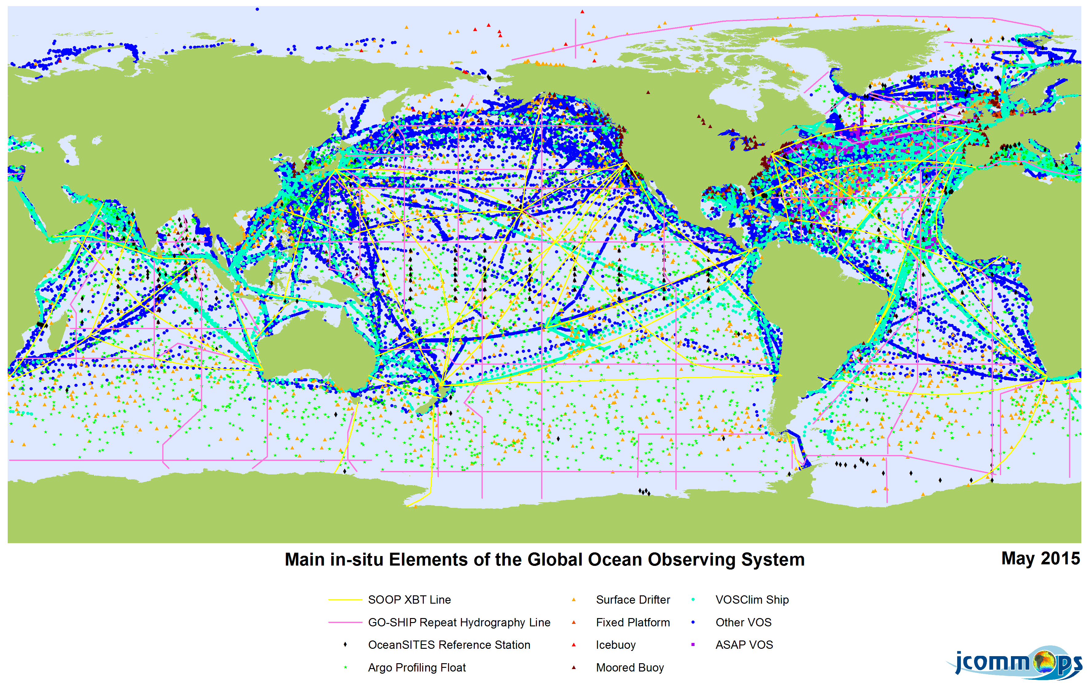
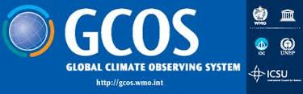

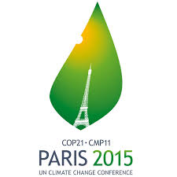
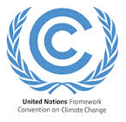
UNFCCC – Global Observing System for Climate
Global Ocean Observing System
2016
Implemenation Plan
2015
Status Report
Notes:
Within the UNFCCC there are several ways of addressing ocean science challenges within the framework of climate change. Let me introduce 2.
First of all, the GCOS (coordinated by WMO-IOC-UNEP-ICSU) has submitted its report Status of the Global Observing System for Climate to the Subsidiary Body for Scientific and Technological Advice (SBSTA) to the UNFCCC in December in Paris. This report was invited by the Parties to the UNFCCC at the thirty-third session of the SBSTA in Cancún, Mexico, in 2010. One third of the presented results are focusing on ocean/coastal related issues. In summary it highlights the value of global long-term observing systems to assess the impacts of climate change in the Open Ocean and coastal seas. In 2016 at the UNFCCC/COP-22 in Morocco, GCOS will submit an implementation plan that addresses some of the gaps identified in this year’s status report, again stressing the importance of ocean observations. Clear actions to maintain ongoing measurements and establish new observation/monitoring strategies have to be included, which are intended to result in member state commitments.

Slide 4
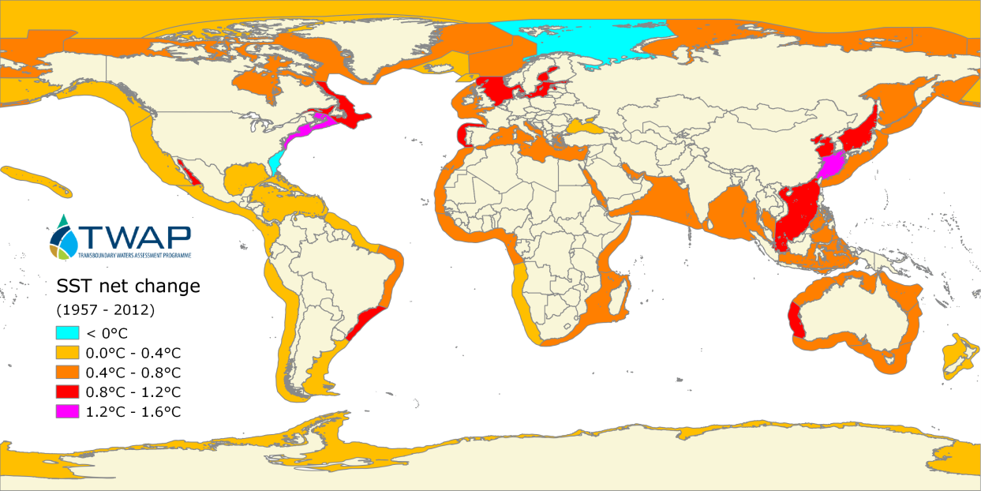
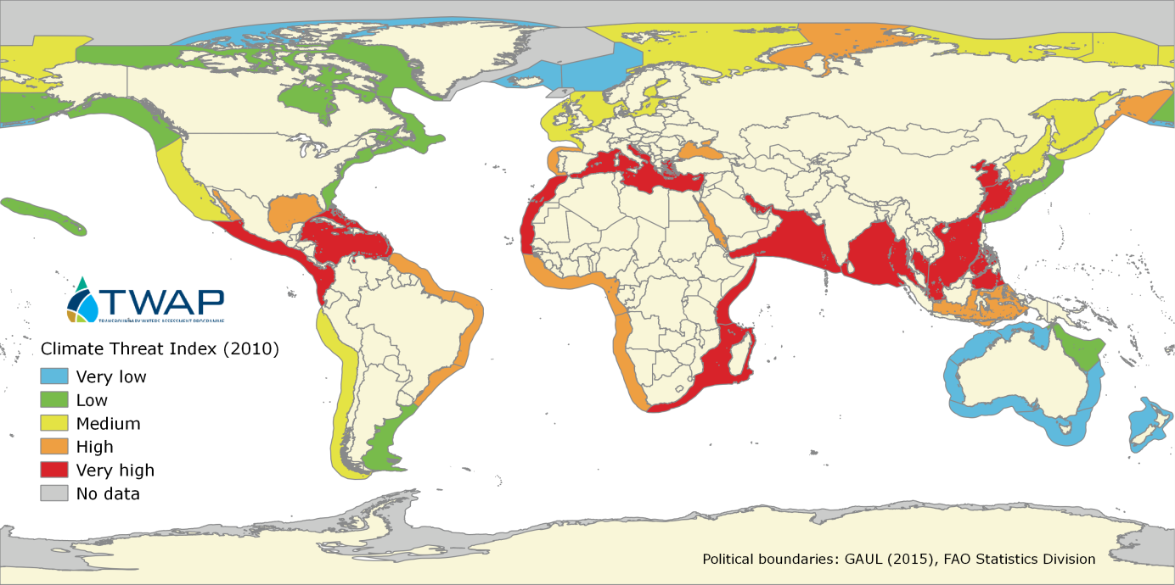
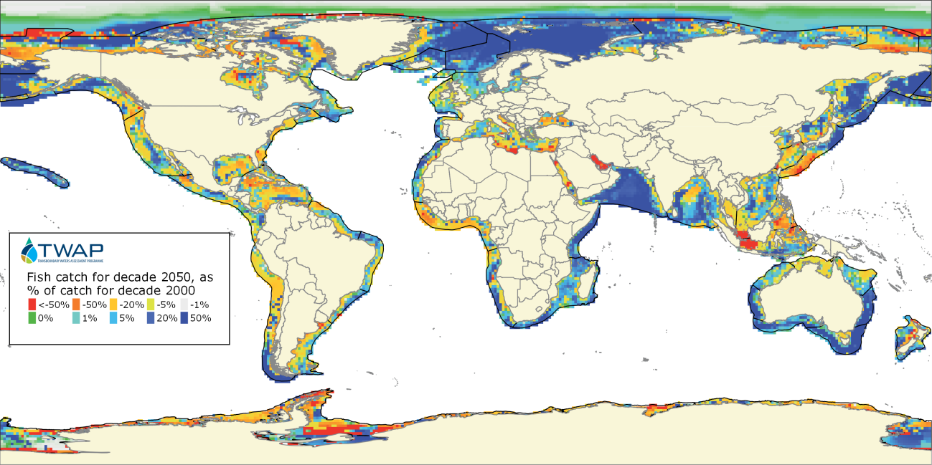
We need capacity for transforming data into policy-relevant information
Transboundary Waters Assessment
Programme (TWAP)
Change in Sea Surface Temperature
Climate Threat Index (Present-Day)
Projection of the fish catch for decade 2050, as a percentage of catch in decade 2000.
Notes:
Change in Sea Surface Temperature: all over the world, the sea surface is warming up, with specific hot spots in East Asia, North America and Northern Europe.
Projection of the fish catch for decade 2050, as a percentage of catch in decade 2000: fish catch seems to be undergoing a net decrease as a result of climate change, particularly around the equator.
Climate Threat Index (Present-Day): The contemporaneous Climate Threat Index (1993-2012) takes into account mortality and property losses due to flooding, storms and extreme temperatures (such as extreme heat and cold events, prolonged drought).

Slide 5
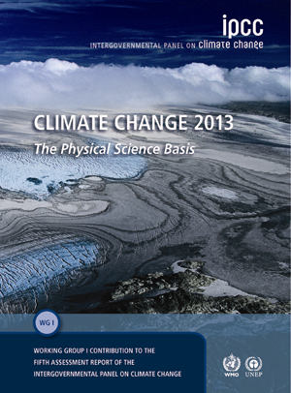
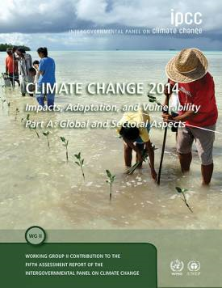
UNFCCC –IPCC Special Report on the OCEAN
IPCC Special Report on the Ocean
Several chapters within the IPCC AR5 WG I/II
Notes:
Asecond way to inform the member states within the UNFCCC about the impacts of climate change on the ocean and what where the knowledge gaps of ocean science are, of course is the IPCC. Although there has been an increase ocean research and observation to understand the physical, chemical, and biological changes within the ocean in response to climate change and ocean acidification, the number of marine studies of ecological impacts and risks still lag behind terrestrial studies and knowledge. Given the importance of the ocean and coastal ecosystems in terms of understanding and responding to future changes and consequences climate change and acidification the report clearly requests to rectify this gap as one major international objective.
Therefore the IOC-UNESCO supports the proposal of an Special IPCC report on the Ocean- this report would integrate and update the assessment of AR5 using this literature, bringing new information into one place. Moreover, it would help to prepare and set the stage for AR6.

Slide 6
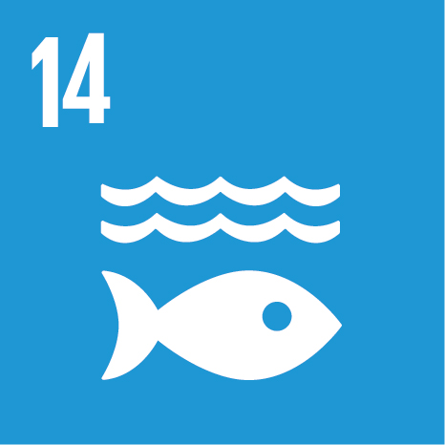

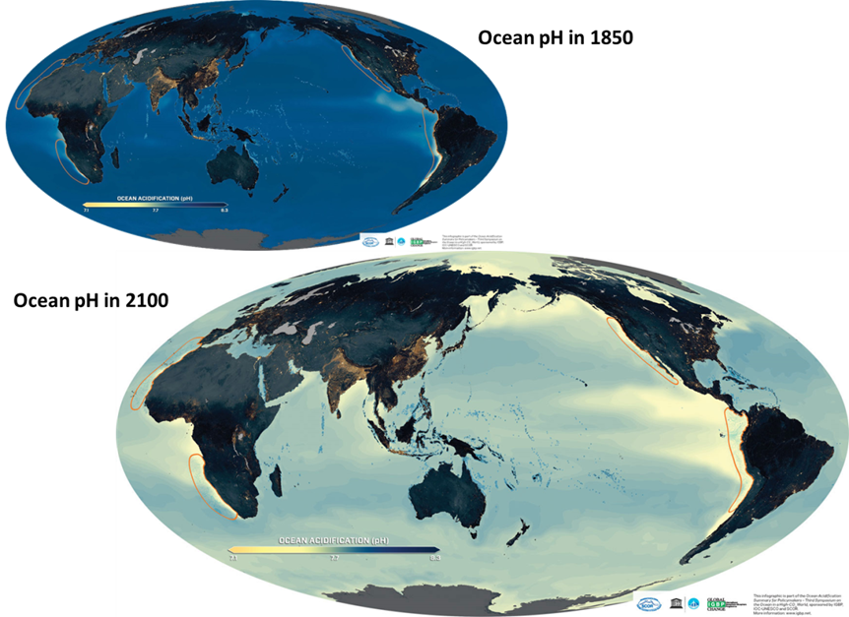
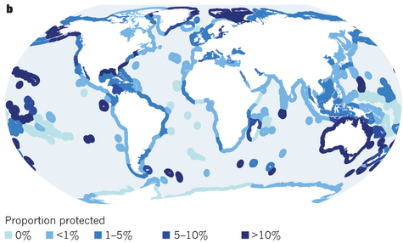
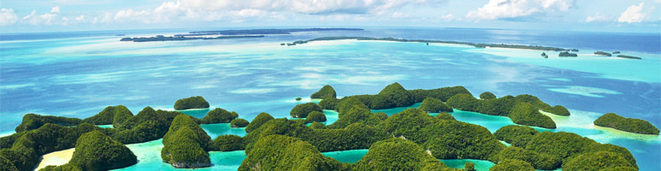
Ocean SDG - Targets
Conserve and sustainably use the oceans, seas and marine resources.
Protecting our oceans is one of 17 Global Goals that make up the 2030 Agenda for Sustainable Development. An integrated approach is crucial for progress across the multiple goals.
Notes:
Outside the UNFCCC are also opportunities to reinforce ocean science among the UN member states.
The recently adopted post 2030 agenda includes the Sustainable Development Goal 14 ‘Conserve and sustainably use the oceans, seas and marine resources’.
The corresponding targets do not solely focus on climate change related issues, nevertheless the majority is clearly relatd, e.g.
Protect marine and coastal ecosystems
Minimize and address the impacts of ocean acidification
By 2020, conserve at least 10 per cent of coastal and marine areas,.
By 2030, SIDS - sustainable use of marine resources.
Increase scientific knowledge, develop research capacity and transfer marine technology
Enhance the conservation and sustainable use of oceans and their resources

Slide 7
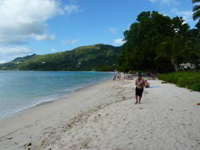

Small Island Developing States –
S.A.M.O.A. Pathway Capacity Development
Notes:
Finally indispensable to mention that the outcome document of the third International Conference on Small Island Developing States (SIDS Conference) called to support ocean research and observations at the global level. The SIDS accelerated modalities of action [S.A.M.O.A.] Pathway reaffirms that climate change is one of the greatest challenges and that sea-level rise, ocean acidification will affect ecosystem services and therefore human wellbeing. A whole section focusses on ocean related issues and supports actions to undertake marine scientific research and to enhance and implement monitoring strategies. Now it is up to us, the UN, the NGOs, academia to support actions proposed by the S.A.M.O.A pathway;
encourage national commitments for long-term observation programmes, in order to be able to respond to the need for increased knowledge to manage marine ecosystems sustainably.

Slide 8
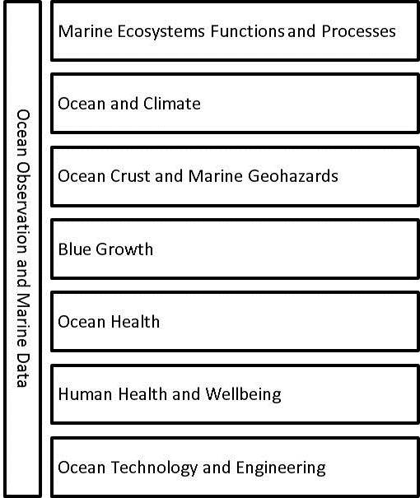
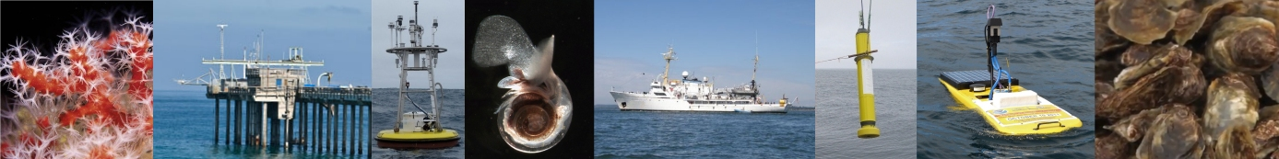
Who needs what in terms of capacity for Observation –
Global Ocean Science Report
GOSR
Investments
Resources
Scientific
capacity
Notes:
But to able to encourage ocean science and observation, there is a need to understand what capacities currently exist. The Global Ocean Science Report will analyze ocean science from the national and global perspective, including quantitative information beneficial for marine scientists like investments, resources and scientific productivity and further global developments in ocean research governance, which is of especially high value for managers, policy makers, governments, etc.
As the GOSR will address the key aspects of ocean science regarding sustainable development and blue growth, the report will help to optimize the sustainable use of marine resources, to encourage capacity-building and transfer of technology marine environment, and to facilitate international cooperation in coastal and global marine research and management.

Slide 9
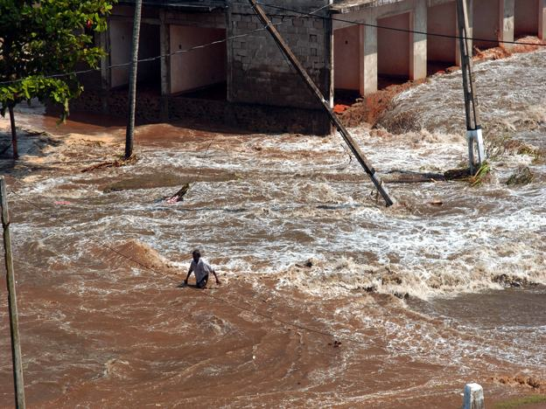
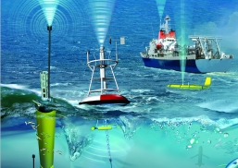
IOC-UNESCO –
Climate Change/Ocean Acidification Research?
Measurements are needed for policy/planning
Measurements are needed for science progress
Measurements need to be regional/global
Notes:
We at IOC are convinced that Measurements of the marine environment are needed for policy
Early warning
Cause and effect
Mitigation
Measurements are needed for science
Understanding variability
Assessing ocean health
Improved forecasting
Measurements need to be regional/global
Regional-Global-scale processes
Data comparisons
Food security

Slide 10
Key messages
Support expansion of GOOS network (ARGO) through
national commitments and increase participation of developing nations
Support Special IPCC report on the Ocean
Implement technical capacity development /transfer of technology programme for developing nations
(esp. SAMOA / SDG decisions)
Improve Ocean Acidification measurements globally and regionally (GOA-ON) / SDG 14.3
Tailor ocean observation strategies to ocean management questions
Notes:
--Encourage the active participation of marine scientists and existing marine observation networks in the preparation of the Global Observing System for Climate (GCOS) implementation plan, envisaged to be presented and discussed at the UNFCCC COP 22
--Support the creation of the IPCC report on Oceans--this report would integrate and update the assessment of AR5 using scientific findings on the central role of oceans and climate and likely scenarios and consequences, as well as help to prepare and set the stage for AR6
--Support observation and science programs to fill the existing data gaps, in particular international collaborations such as the Argo network of oceanographic floats, which illustrate how international cooperation can rapidly improve our understanding of the physical behavior of the ocean providing important insight into its long-term subsurface variability
--Sustained ocean observation should be included as part of national commitments, particularly within the framework of UNFCCC and Agenda 2030/ SDG 14, in response to the call to increase knowledge to manage marine ecosystems sustainably, and understand the impacts of climate change and ocean acidification
--Enhance technical capacity development of vulnerable countries through the establishment of regional oceanographic centers to increase cooperation amongst States on ocean-climate research and multi-disciplinary observation (in accordance with SAMOA Pathways decision 58.f)
--Support actions implemented by the Global Ocean Acidification Network (GOA-ON) to facilitate cooperation and coordination between ongoing and planned ocean acidification observing programs and to deliver the results to enable scientists and policy-makers to develop the best adaptation and mitigation strategies

